Slide 1
Dhanendran S
813821104027
Final Project
Google Stock Price Prediction Using RNN

Slide 2
PROJECT TITLE
Google Stock Price Prediction with Recurrent Neural Networks
This project aims to leverage the power of Recurrent Neural Networks (RNNs) for accurate prediction of Google stock prices.
RNNs, with their ability to capture sequential dependencies in data, are ideal for time-series forecasting tasks like stock price prediction.
Through this project, historical stock price data of Google will be collected and preprocessed to train the RNN model.

Slide 3


AGENDA
Introduction
Problem statement
Project overview
End users
Value and proposition
Modelling
Result
3/21/2024 Annual Review

Slide 4

PROBLEM STATEMENT
Google stock price prediction using RNN based LSTM.
Developing a robust predictive model for Google stock price prediction using RNNs involves addressing challenges in managing complex historical data, designing effective RNN architectures, optimizing training procedures, and validating predictive accuracy.
Overcoming these challenges is essential for providing actionable insights and decision-making support to stakeholders navigating the dynamic landscape of financial markets.

Slide 5

PROJECT OVERVIEW
Dataset: Google's stock market data
Preprocessing: Normalization of the data using MinMaxScaler
Model: Long short-term memory(LSTM), Recurrent Neural Network (RNN)
Training set: Past 60 days data of opening stock value as the learning parameters for the LSTM to predict the next day market opening stock value.
Result: Various plots for different experimentations are shown below to understand how the model behaves over the given data showing various parameters dependence.

Slide 6

WHO ARE THE END USERS?
Investors: Individuals or institutions seeking insights to make informed decisions on buying, selling, or holding Google stocks based on predicted price trends.
Traders: Active market participants aiming to capitalize on short-term price movements by leveraging timely and accurate predictions provided by the model.
Financial Analysts: Professionals analyzing market trends and performance to provide recommendations and insights to clients or stakeholders.
Portfolio Managers: Individuals responsible for managing investment portfolios who utilize the predictions to optimize asset allocation and risk management strategies.
Researchers: Academics and researchers studying financial markets who can use the project's findings to enhance understanding and develop further advancements in predictive modeling techniques.

Slide 7

YOUR SOLUTION AND ITS VALUE PROPOSITION
Design an LSTM-based RNN architecture comprising multiple layers of LSTM cells, followed by a dense layer for prediction.Utilize techniques such as dropout regularization to prevent overfitting and improve generalization.
Different types of plots illustrating different experiments, shedding light on how the model behaves concerning the provided data and showing dependencies on various parameters.
Accurate results and an overall loss of around (~0.15%) which is 0.0015 validation loss.

Slide 8

THE WOW IN YOUR SOLUTION
Accurate Predictions
Timely Insights
Decision-Making Support
Enhanced Efficiency
Adaptability and Scalability
3/21/2024 Annual Review

Slide 9
MODELLING
Language: Python
Required modules: numpy, keras, scikit-learn, matplotlib
Dataset: Google_Stock_Price_Train.csv, Google_Stock_Price_Test.csv
Model: Long short-term memory (LSTM), Recurrent Neural Network (RNN)
Data Preprocessing: Clean and preprocess and split the data into training, validation, and testing sets.
Model Architecture: The project is the implementation of Stock Market Price Prediction using a Long Short-Term Memory type of Recurrent Neural Network with 4 hidden layers of LSTM and each layer is added with a Dropout of 0.2 and tested on various values in the Experimentations.
Training: Train the LSTM model using the training data, adjusting model parameters iteratively to minimize the loss function.
Validation: Overall loss of around (~0.15%) which is 0.0015 validation loss over 120 days past data training running for 100 epochs, calculated as Root mean squared error calculation.

Slide 10
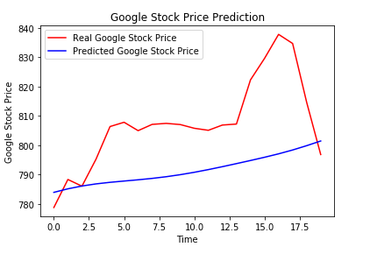
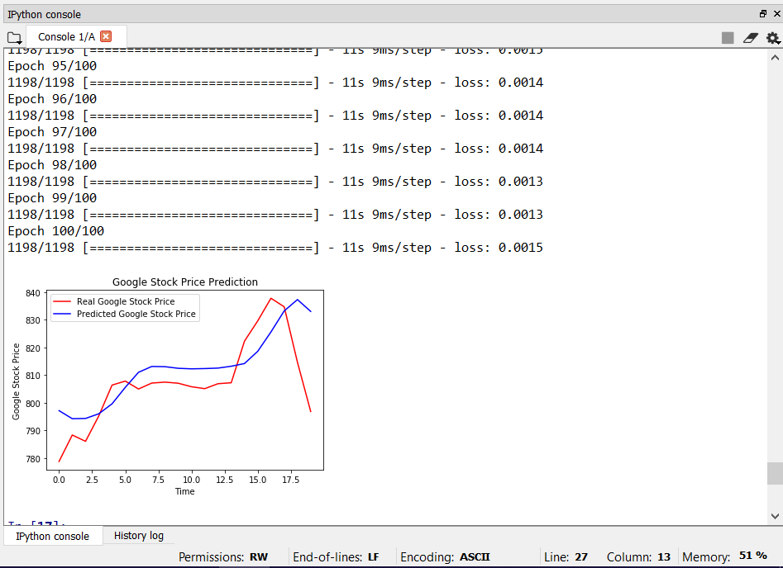
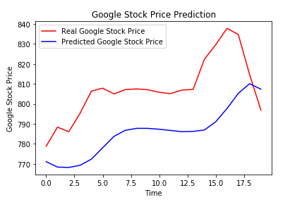
RESULTS
Project Link: https://github.com/Dhanendran17/Generative-AI.git

